Slide 1



Demo_shareBike_shukKwanChan
View in Power BI
Last data refresh:
3/5/2024 6:06:03 AM UTC
Downloaded at:
3/5/2024 6:21:16 AM UTC

Slide 2
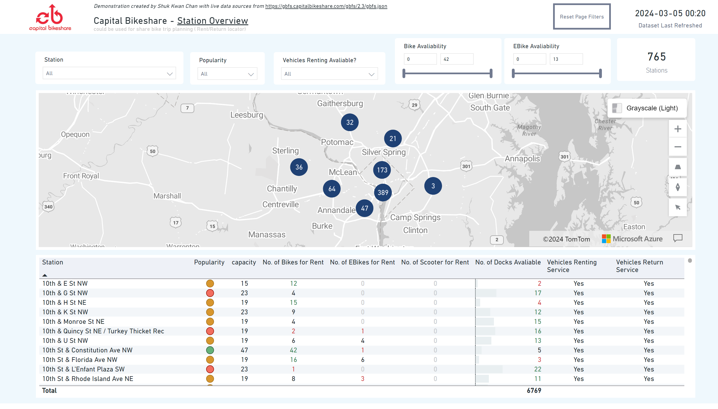
Station Overview
Notes:
azureMap
No alt text provided
card
No alt text provided
tableEx
No alt text provided
card
No alt text provided
slicer
No alt text provided
slicer
No alt text provided
slicer
No alt text provided
slicer
No alt text provided
image
No alt text provided
shape
No alt text provided
textbox
No alt text provided
slicer
No alt text provided
actionButton
No alt text provided

Slide 3
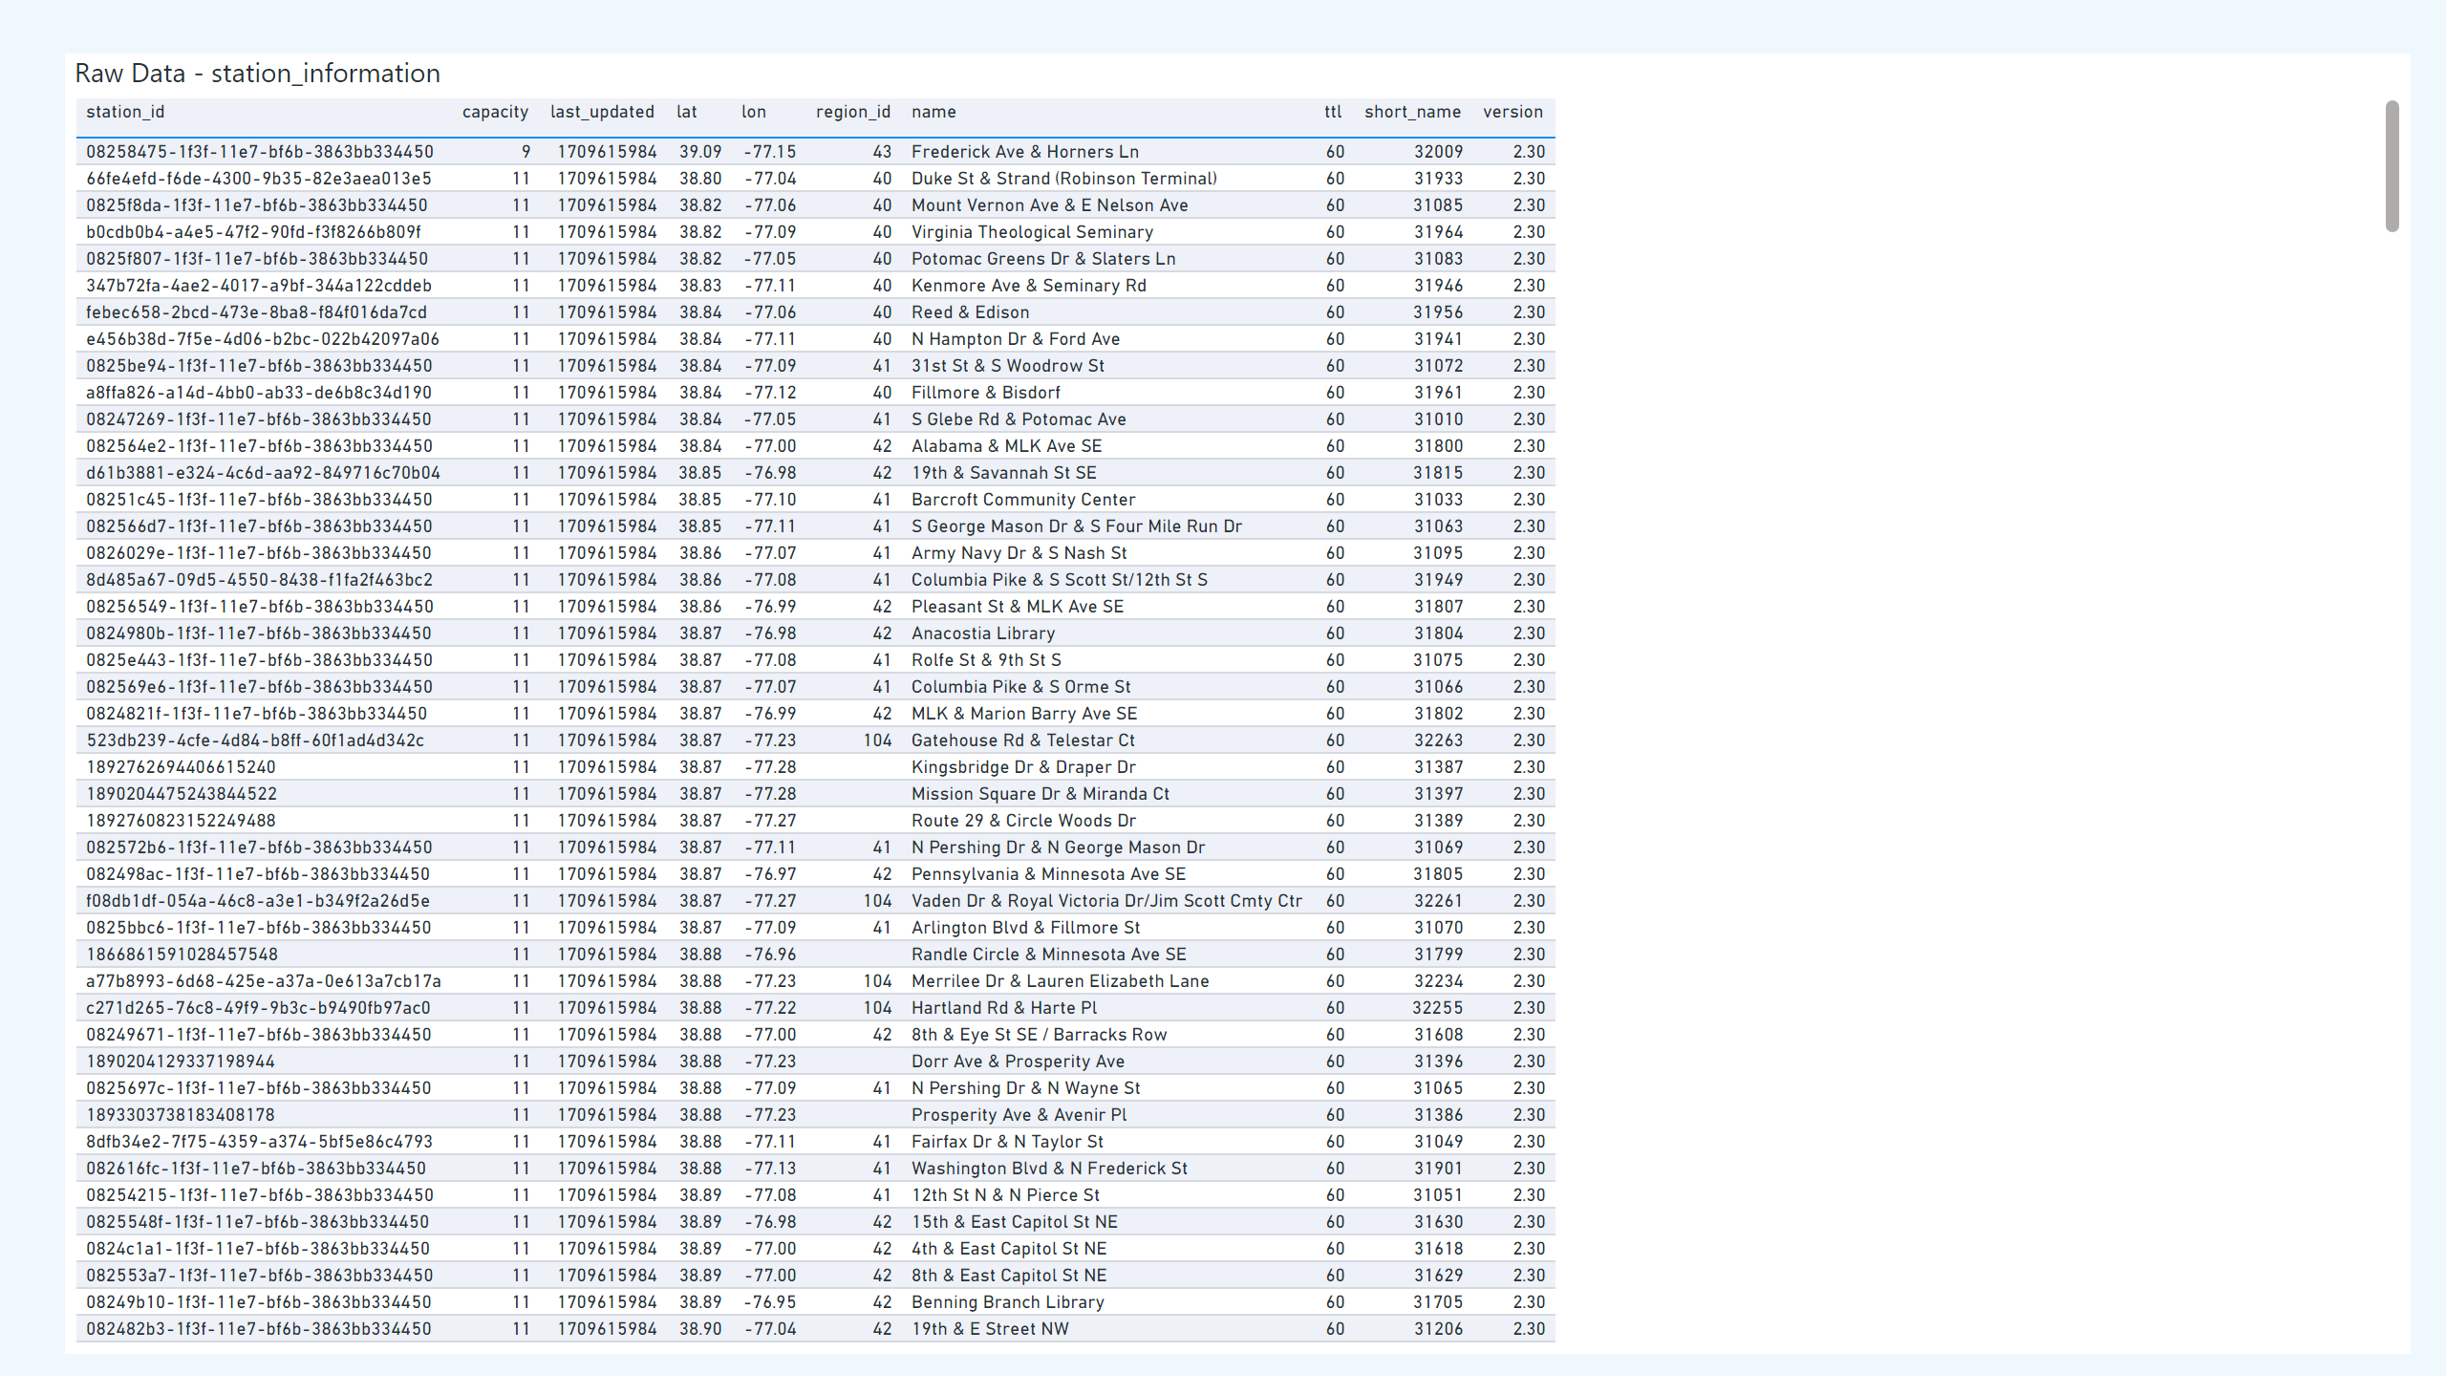
station_information
Notes:
Raw Data - station_information
No alt text provided

Slide 4
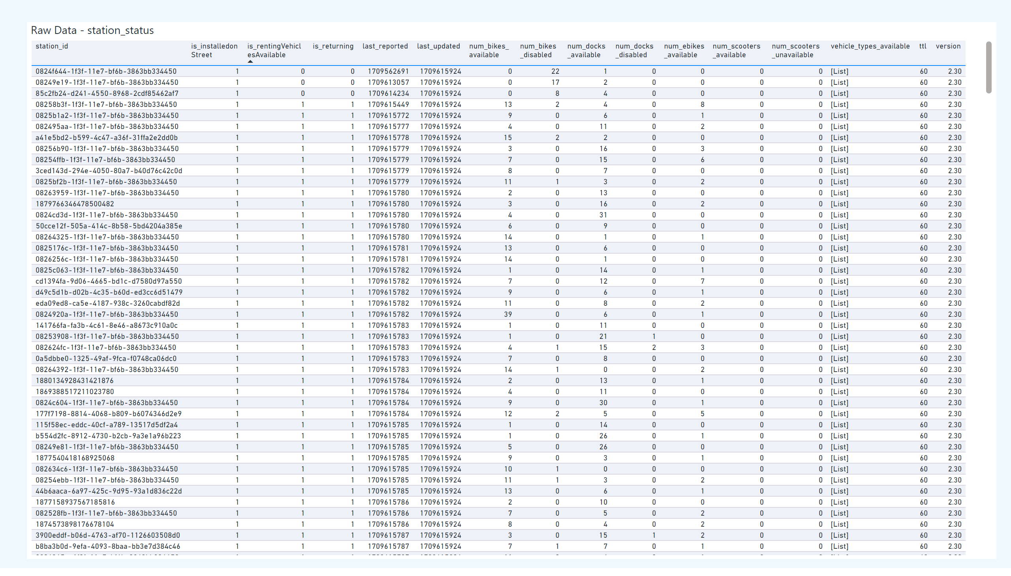
station_status
Notes:
Raw Data - station_status
No alt text provided

